Slide 1
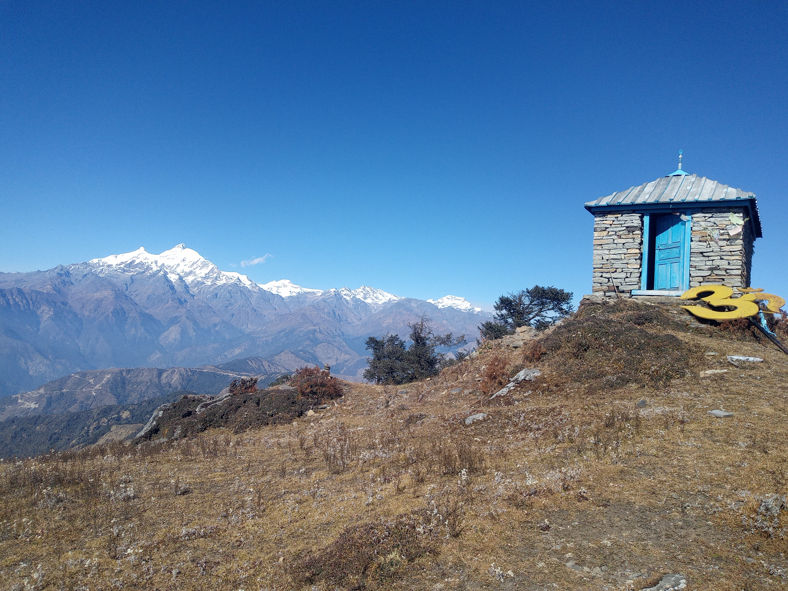
 | NEPAL

Slide 2
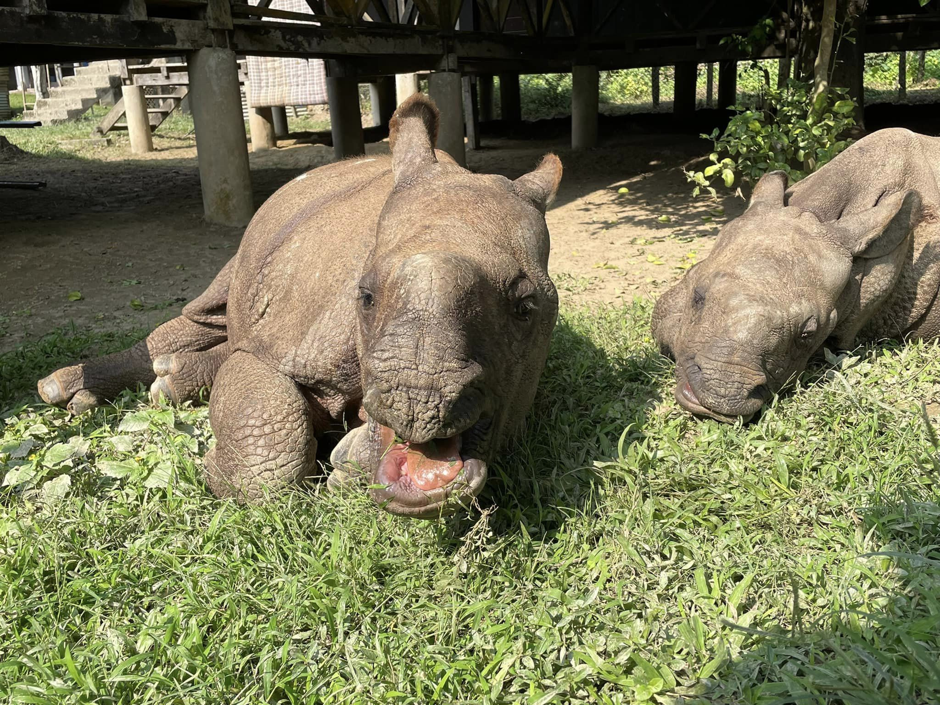
BIODIVERSITY |  |  |  | Rihnos
Crocodiles
 |  |  | Tigers

Slide 3
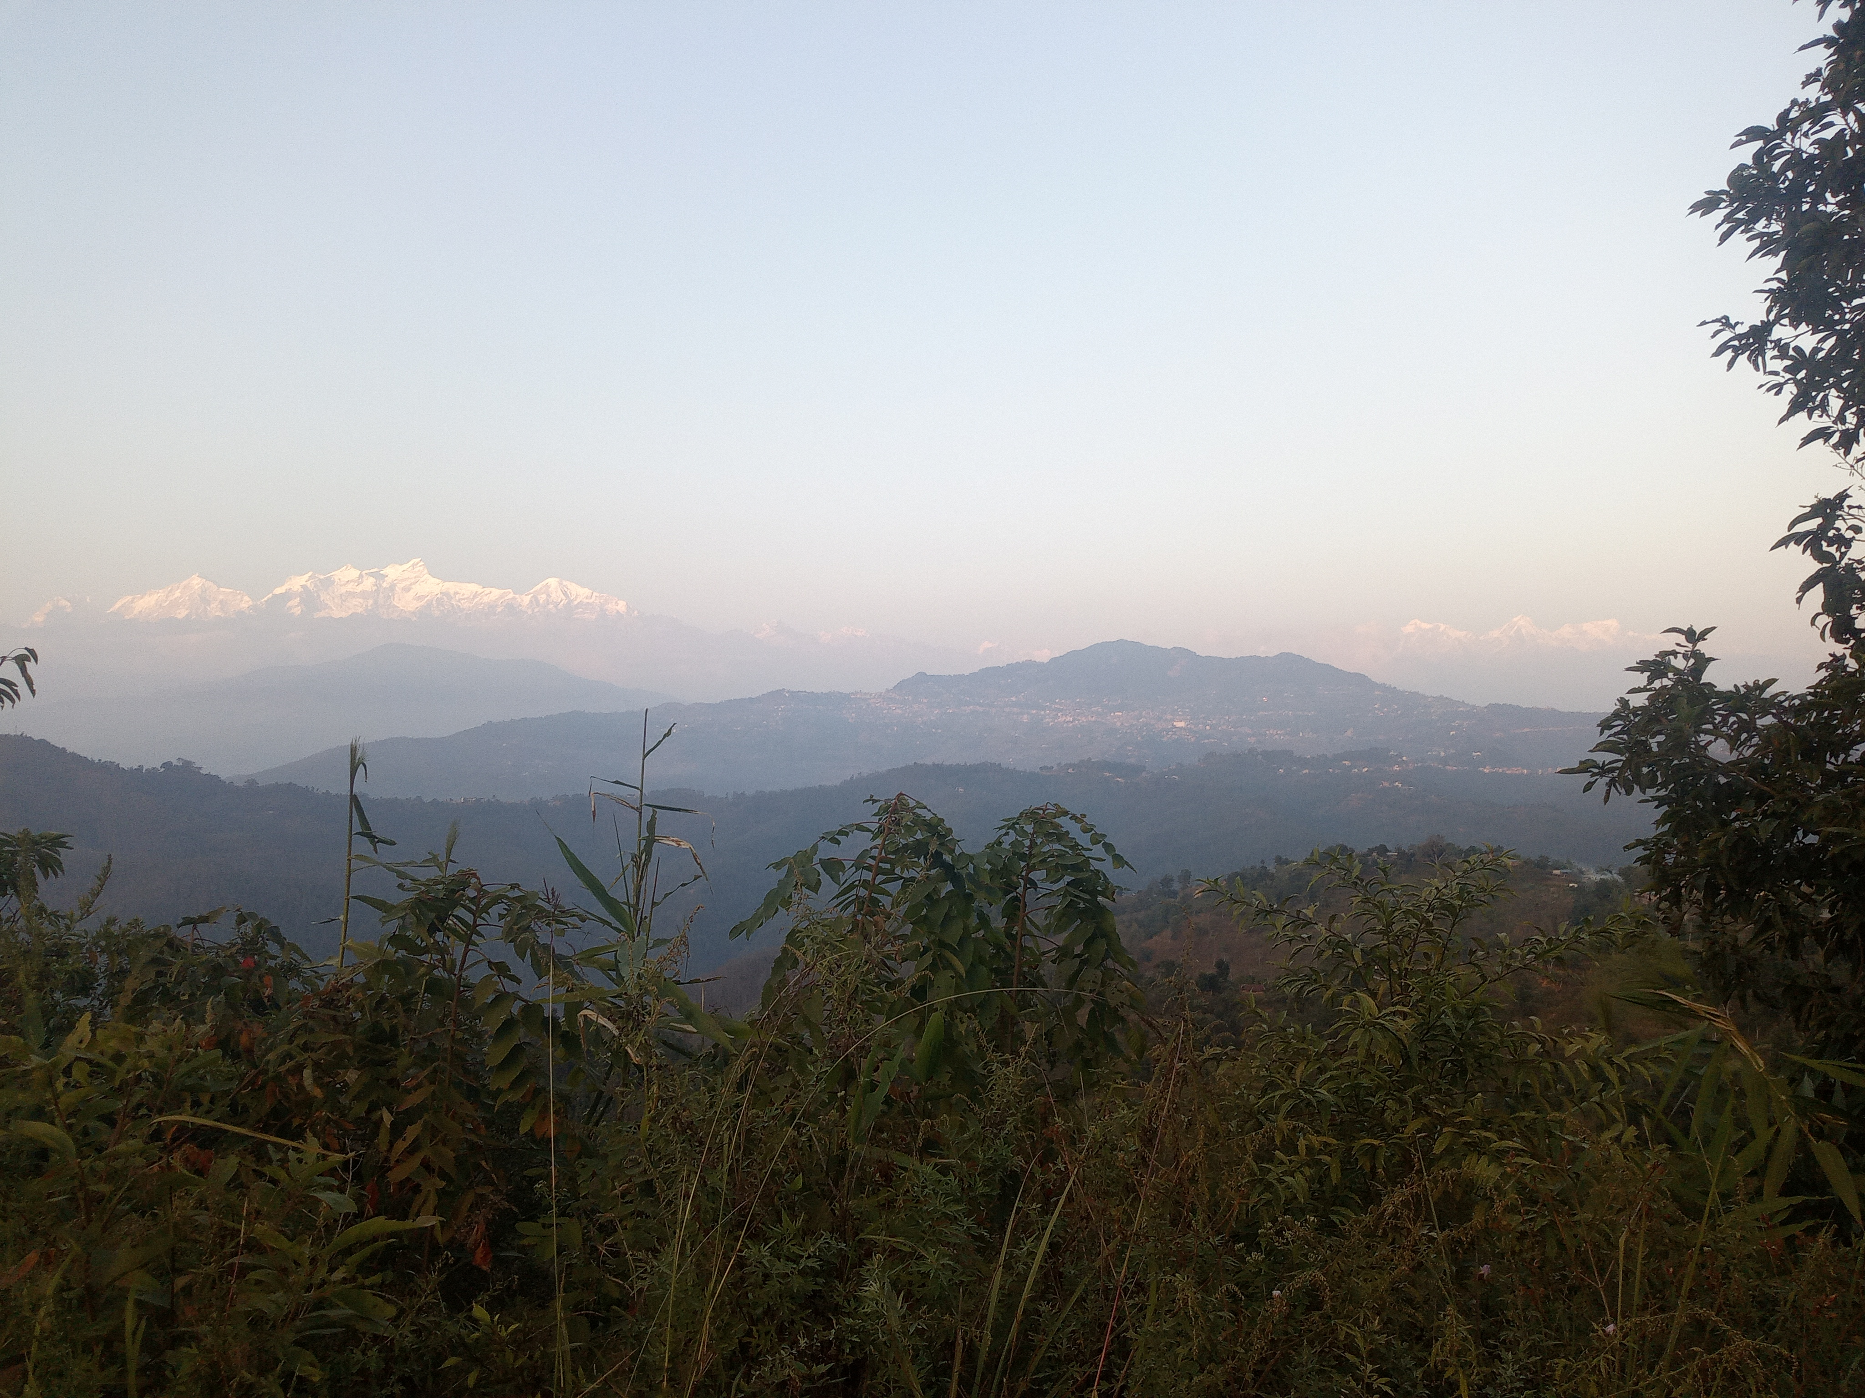
 |  | DIVERSE LANDSCAPE

Slide 4
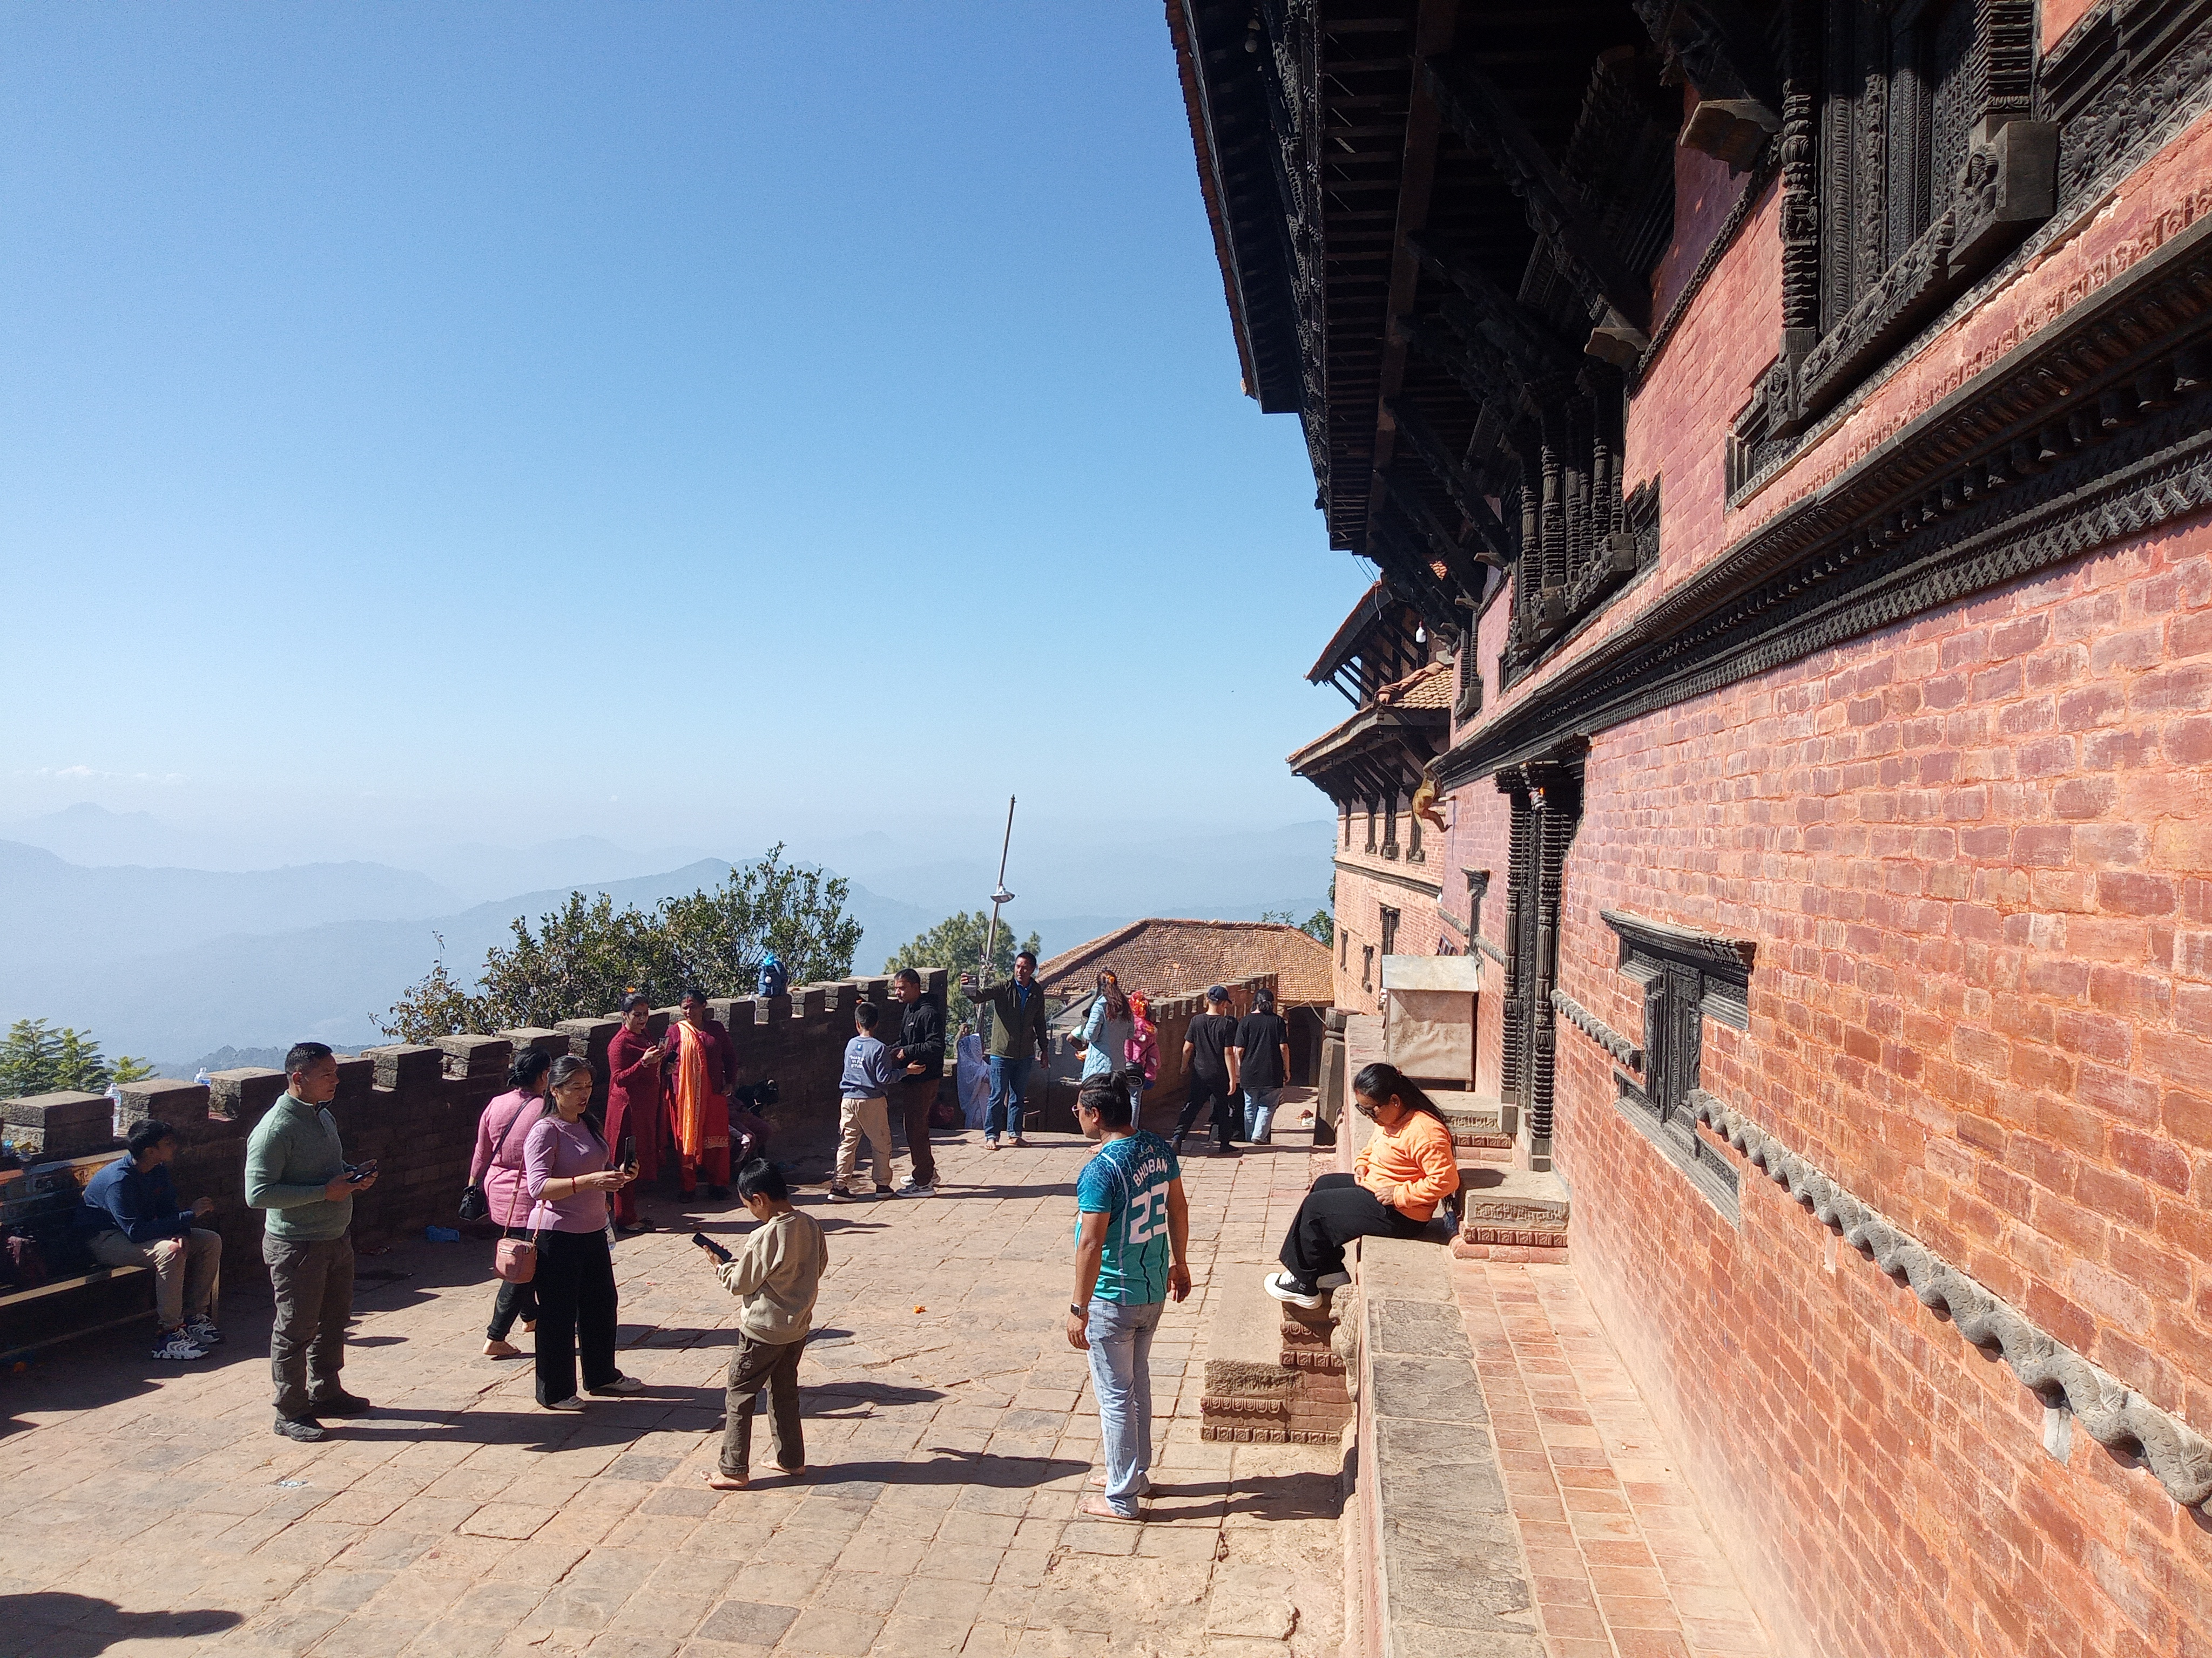
RICH CULTURE
 | 10 UNESCO World Heritage Sites

Slide 5
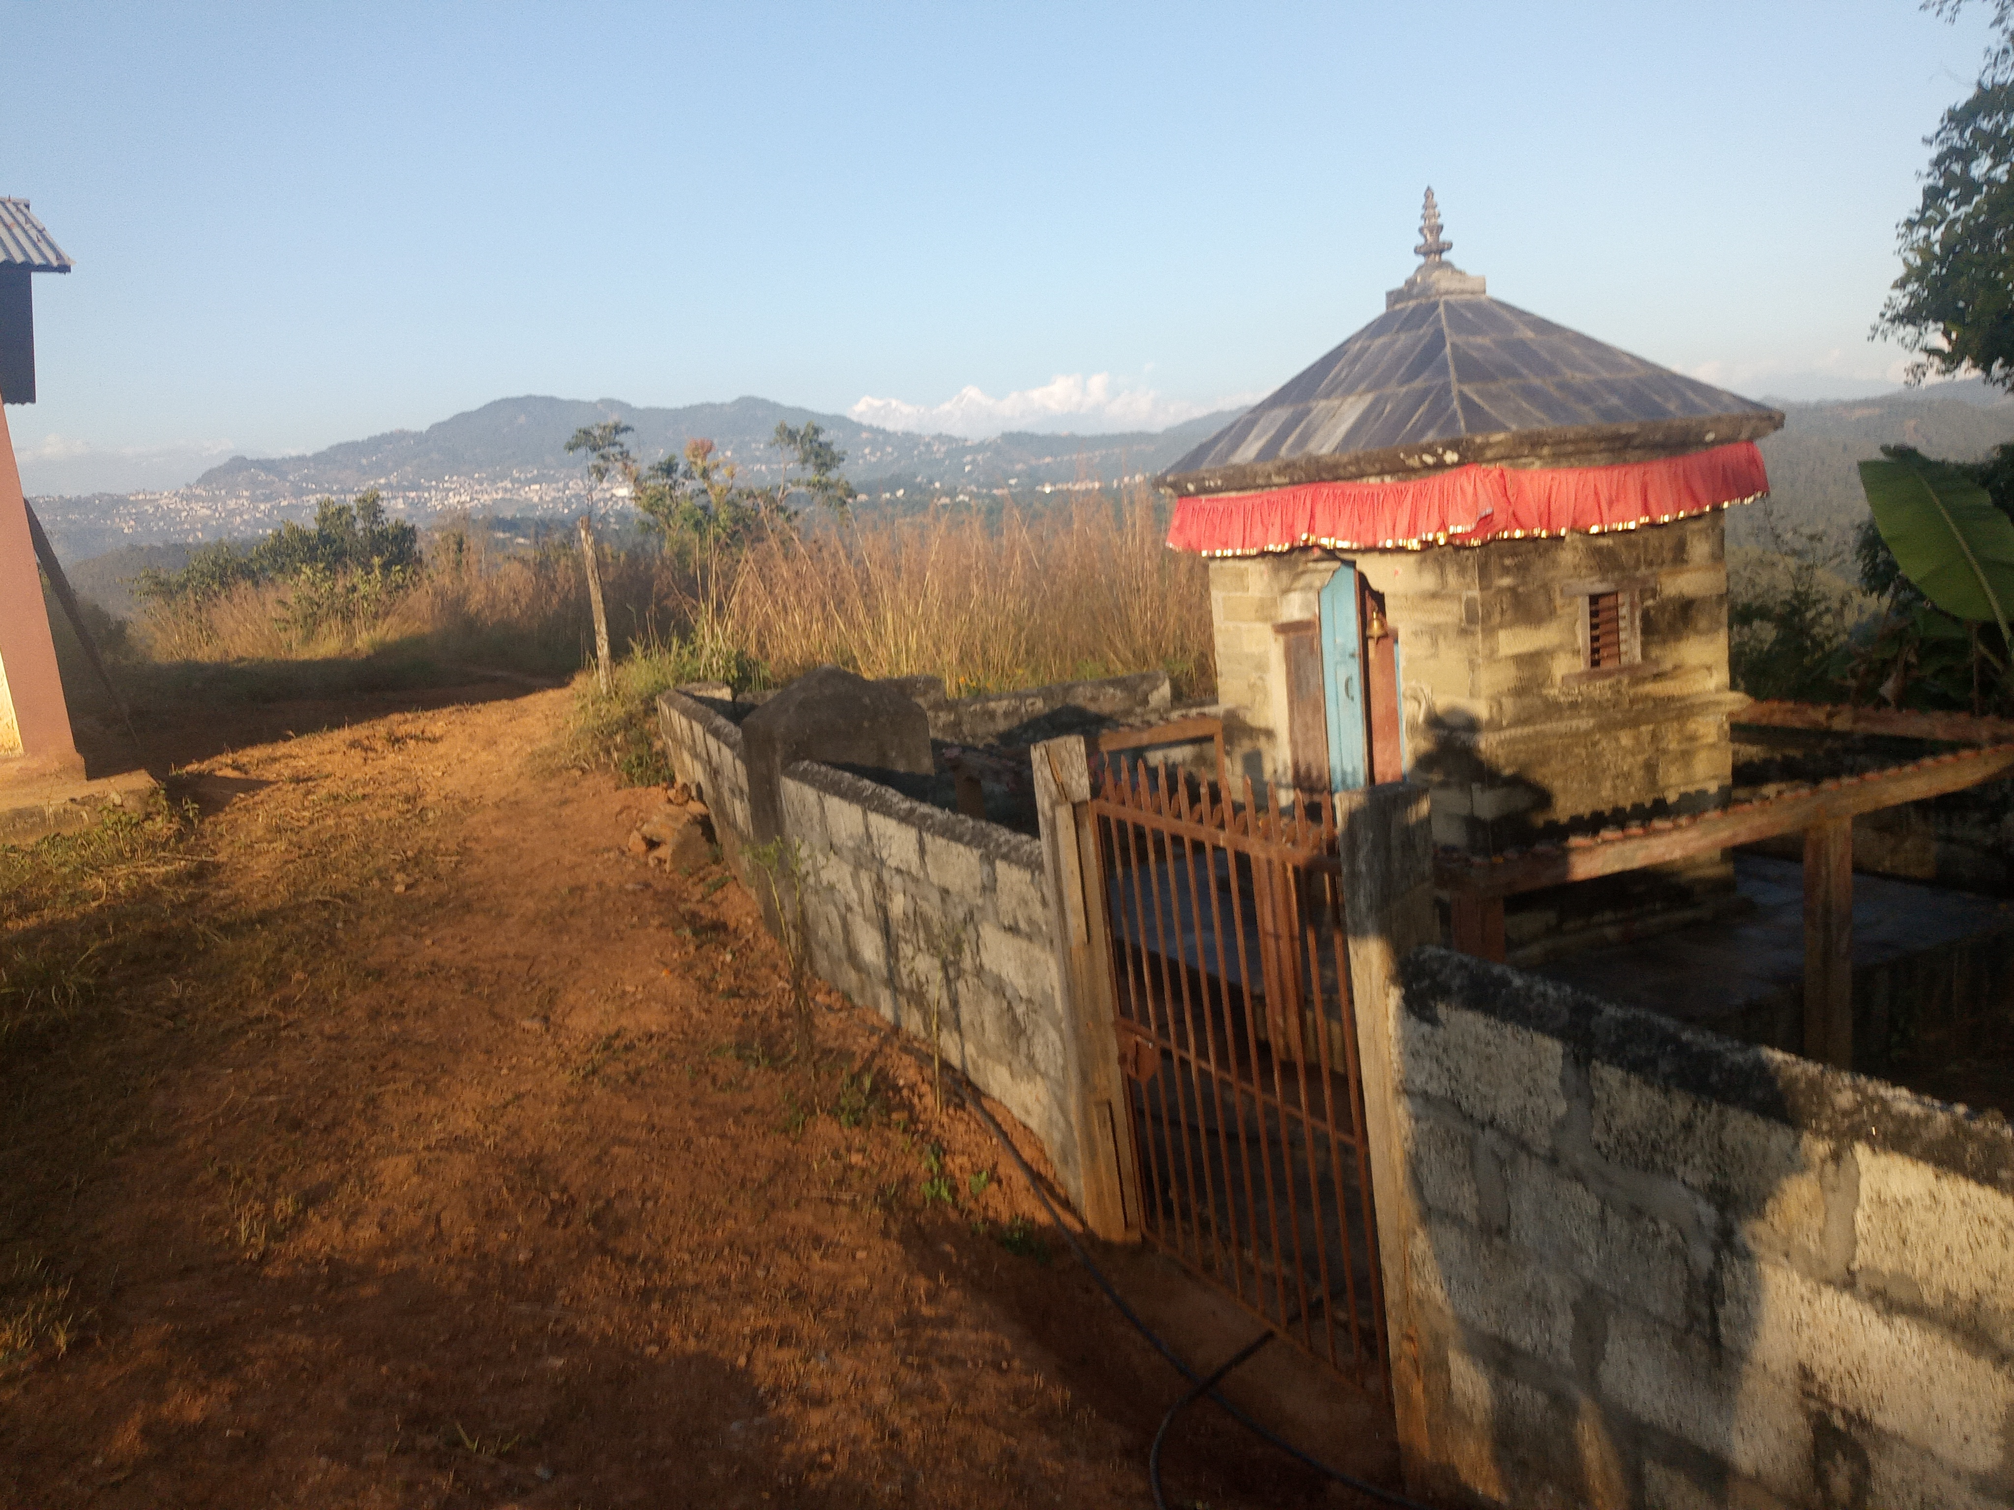
LAND OF DIFFERENT
 | Cultures |  | Religions |  | Languages

